Slide 1
SRM Institute of Science and Technology School of Computing Advanced Programming Practice-18CSC207J Structured Programming

Slide 2
Structured Programming Paradigm
Unit-I (15 Session)
Session 1-5 cover the following topics:-
Structured Programming Paradigm
Programming Language Theorem
Böhm-Jacopini theorem
Sequence, Selection,Decision,Iteration and Recursion
Other Languages : C/C++/Java /C# /Ruby
Demo: Structured Programing in Python
Lab 1: Structured Programming
TextBook: Shalom, Elad. A Review of Programming Paradigms Throughout the History: With a Suggestion Toward a Future Approach, Kindle Edition

Slide 3
Structured Programming
Structured programming is a paradigm that is based on improving clarity and quality of programs by using subroutines, block structures and loops (for and while) and discouraging the use of goto statement.
1. History
2. Overview
3. Component
4. Representations in different languages(C,C++,Java,python)

Slide 4
History
The Böhm-Jacopini theorem, also called structured program theorem, stated that working out a function is possible by combining subprograms in only three manners:
Executing one subprogram, and the other subprogram (sequence) .
Executing one of two subprograms according to the value of a Boolean expression (selection) .
Executing a subprogram until a Boolean expression is true (iteration)
Some of the languages that initially used structured approach are ALGOL, Pascal, PL/I and Ada.
By the end of the 20th century, concepts of structured programming were widely applied so programming languages that originally lacked structure now have it (FORTRAN, COBOL and BASIC). Now, it is possible to do structured programming in any programming language (Java, C++, Python ...).

Slide 5
2. Overview
Structured programming was defined as a method used to minimize complexity that uses:
1. Top-down analysis for problem solving :-
Top-down analysis includes solving the problem and providing instructions for every step. When developing a solution is complicated, the right approach is to divide a large problem into several smaller problems and tasks.
2. Modularization for program structure and organization :
Modular programming is a method of organizing the instructions of a program. Large programs are divided into smaller sections called modules, subroutines, or subprograms. Each subroutine is in charge of a specific job.

Slide 6
3. Structured code for the individual modules:
Structured coding relates to division of modules into set of instructions organized within control structures. A control structure defines the order in which a set of instructions are executed. The statements within a specific control structure are executed:
sequentially – denotes in which order the controls are executed. They are executed one after the other in the exact order they are listed in the code.
conditionally – allows choosing which set of controls is executed. Based on the needed condition, one set of commands is chosen while others aren’t executed.
repetitively – allows the same controls to be performed over and over again. Repetition stops when it meets certain terms or performs a defined number of iterations.

Slide 7
3.Component
3.1 Structograms - graphical representation of structured programming(Flowchart).
3.2 Subroutine - Subroutine is a sequence of program instructions packaged as a unit so that together they perform a specific task.
3.3 Block- Block is a section of code grouped together and it consists of one or more declarations and statements.(ex: { ….}
3.4 Indentation- Another typical characteristic of structured programming is indent style applied to a block to display program structure. In most programming languages, indentation is not a requirement but when used, code is easier to read and follow.
3.5. Control structure – sequence, selection and iteration

Slide 8
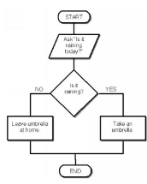
Component
Structograms or Nassi–Shneiderman -graphical representation of structured programming.
Structograms can be compared to flowcharts.
Nassi–Shneiderman diagrams have no representation for a goto statement.
Ex:-

Slide 9
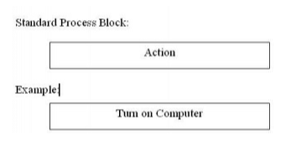
Structograms use the following diagrams:
1.process blocks - Process blocks represent the simplest actions and don’t require analysis. Actions are performed block by block.

Slide 10
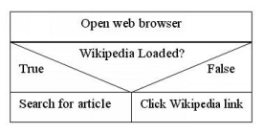
2.branching blocks
Branching blocks are of two types – True/False or Yes/No block and multiple branching block.

Slide 11
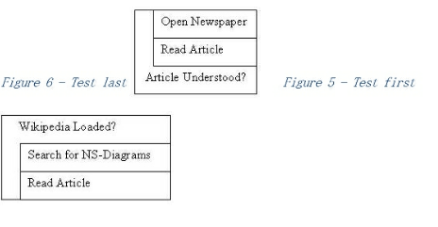
3.Testing loops
Testing loops allow the program to repeat one or many processes until a condition is fulfilled. There are two types of testing loops – test first and test last blocks – and the order in which the steps are performed is what makes them different.

Slide 12
Advantages of structured programming are:
Programs are more easily and more quickly written.
Programs have greater reliability.
Programs require less time to debug and test.
Programs are easier to maintain.

Slide 13
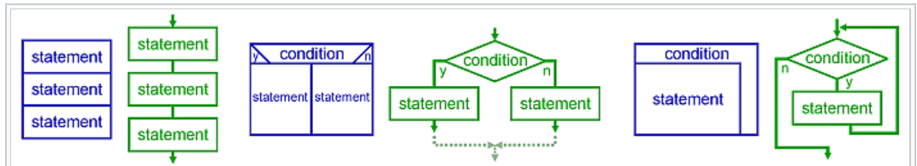
Control structure – sequence, selection ,iteration and recursion. (example for Control structure)
Recursion:
Recursion"; a statement is executed by repeatedly calling itself until termination conditions are met. While similar in practice to iterative loops, recursive loops may be more computationally efficient, and are implemented differently as a cascading stack.
Graphical representation of the three basic patterns — sequence, selection, and repetition

Slide 14
Control Structure - DECISION MAKING (PYTHON )
Decision making statements in programming languages decides the direction of flow of program execution. Decision making statements available in python are:
if statement :
It is used to decide whether a certain statement or block of statements will be executed or not i.e if a certain condition is true then a block of statement is executed otherwise not.
Syntax:
if condition:
# Statements to execute if
# condition is true
Example :
i = 10
if (i > 15):
print ("10 is less than 15")
print ("I am Not in if"

Slide 15
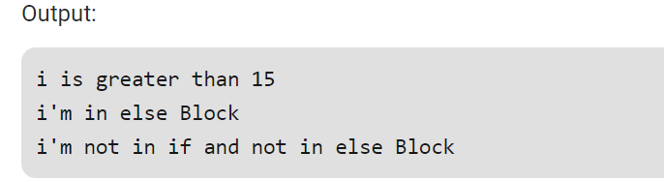
if..else statements:
We can use the else statement with if statement to execute a block of code when the condition is false.
Syntax:
if (condition):
# Executes this block if
# condition is true
else:
# Executes this block if
# condition is false
Example :
i = 20;
if (i < 15):
print ("i is smaller than 15")
print ("i'm in if Block")
else:
print ("i is greater than 15")
print ("i'm in else Block")
print ("i'm not in if and not in else Block")

Slide 16
nested if statements
Python allows us to nest if statements within if statements. i.e, we can place an if statement inside another if statement.
Syntax:
if (condition1):
# Executes when condition1 is true
if (condition2):
# Executes when condition2 is true
# if Block is end here
# if Block is end here

Slide 17
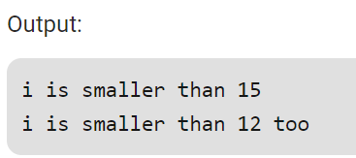
Example : Nested if else
i = 10
if (i == 10):
# First if statement
if (i < 15):
print ("i is smaller than 15")
# Nested - if statement
# Will only be executed if statement above
# it is true
if (i < 12):
print ("i is smaller than 12 too")
else:
print ("i is greater than 15")

Slide 18
if-elif-else ladder
Here, a user can decide among multiple options. The if statements are executed from the top down. As soon as one of the conditions controlling the if is true, the statement associated with that if is executed, and the rest of the ladder is bypassed. If none of the conditions is true, then Syntax:-
Syntax:-
if (condition):
statement
elif (condition):
statement
else:
statement the final else statement will be executed.

Slide 19
example
i = 20
if (i == 10):
print ("i is 10")
elif (i == 15):
print ("i is 15")
elif (i == 20):
print ("i is 20")
else:
print ("i is not present")

Slide 20
CONDITION | SYNTAX
SIMPLE IF | if test expression: statement(s)
IF….ELSE | if test expression: Body of if else: Body of else
IF...ELIF...ELSE | if test expression: Body of if elif test expression: Body of elif else: Body of else
NESTED IF | if test expression: if test expression: Body of if else: Body of else else: Body of else

Slide 21
Conditional Expression
A conditional expression evaluates an expression based on a condition.
Conditional expression is expressed using if and else combined with expression
Syntax:
expression if Boolean-expression else expression
Example:
Biggest of two numbers
num1 = 23
num2 = 15
big = num1 if num1 > num2 else num2
print ( “ the biggest number is “ , big )
Even or odd
print ( “ num is even “ if num % 2 == 0 else “ num is odd “)

Slide 22
Iteration – Loops
Python has two primitive loop commands:
while loops
for loops

Slide 23
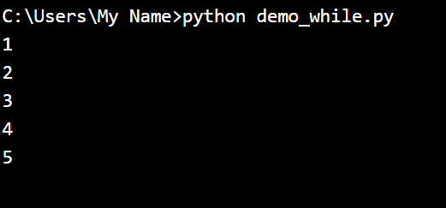
The while Loop
With the while loop we can execute a set of statements as long as a condition is true
Example
Print i as long as i is less than 6:
i = 1 while i < 6: print(i) i += 1
Note: remember to increment i, or else the loop will continue forever.

Slide 24
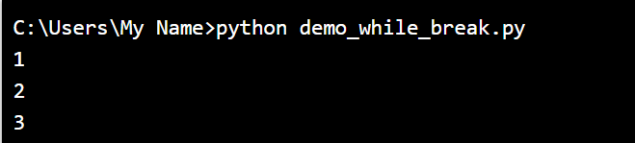
The break Statement
With the break statement we can stop the loop even if the while condition is true:
Example
Exit the loop when i is 3:
i = 1
while i < 6:
print(i)
if i == 3:
break
i += 1

Slide 25
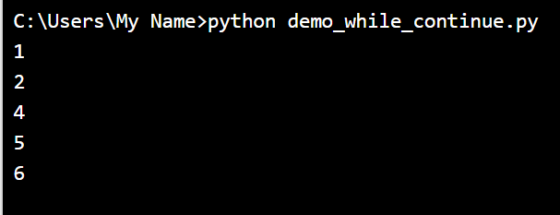
The continue Statement
With the continue statement we can stop the current iteration, and continue with the next:
Example
Continue to the next iteration if i is 3:
i = 0 while i < 6: i += 1 if i == 3: continue print(i)

Slide 26
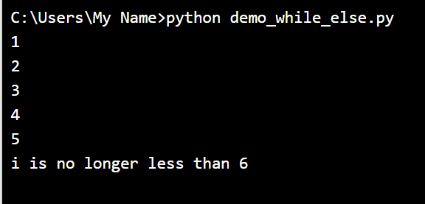
The else Statement
With the else statement we can run a block of code once when the condition no longer is true:
Example
Print a message once the condition is false:
i = 1 while i < 6: print(i) i += 1 else: print("i is no longer less than 6")

Slide 27
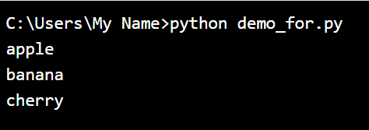
For Loops
A for loop is used for iterating over a sequence (that is either a list, a tuple, a dictionary, a set, or a string).
This is less like the for keyword in other programming languages, and works more like an iterator method as found in other object-orientated programming languages.
With the for loop we can execute a set of statements, once for each item in a list, tuple, set etc.
Example
Print each fruit in a fruit list:
fruits = ["apple", "banana", "cherry"]
for x in fruits:
print(x)
The for loop does not require an indexing variable to set beforehand

Slide 28
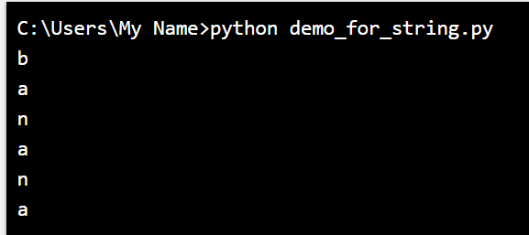
Looping Through a String
Even strings are iterable objects, they contain a sequence of characters:
Example
Loop through the letters in the word "banana":
for x in "banana": print(x)

Slide 29
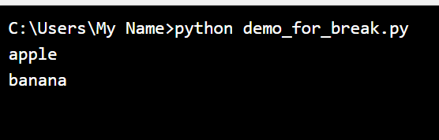
The break Statement
With the break statement we can stop the loop before it has looped through all the items:
Example
Exit the loop when x is "banana":
fruits = ["apple", "banana", "cherry"]
for x in fruits:
print(x)
if x == "banana":
break

Slide 30
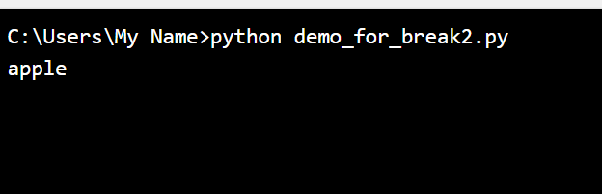
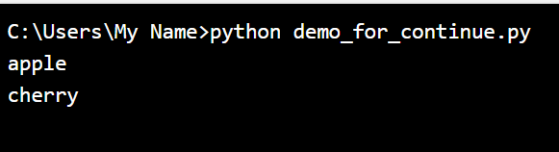
Example
Exit the loop when x is "banana", but this time the break comes before the print:
fruits = ["apple", "banana", "cherry"]
for x in fruits:
if x == "banana":
break
print(x)
The continue Statement
With the continue statement we can stop the current iteration of the loop, and continue with the next:
Example
Do not print banana:
fruits = ["apple", "banana", "cherry"]
for x in fruits:
if x == "banana":
continue
print(x)

Slide 31
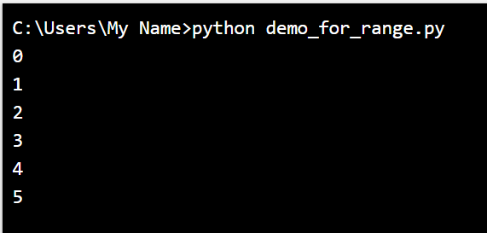
The range() Function
To loop through a set of code a specified number of times, we can use the range() function,
The range() function returns a sequence of numbers, starting from 0 by default, and increments by 1 (by default), and ends at a specified number.
Example
Using the range() function:
for x in range(6): print(x)
Note that range(6) is not the values of 0 to 6, but the values 0 to 5.

Slide 32
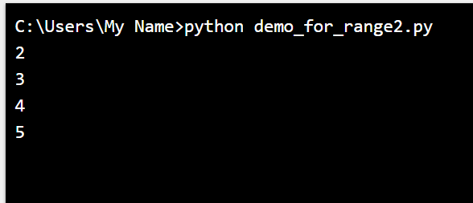
The range() function defaults to 0 as a starting value, however it is possible to specify the starting value by adding a parameter: range(2, 6), which means values from 2 to 6 (but not including 6):
Example
Using the start parameter:
for x in range(2, 6): print(x)
The range() function defaults to increment the sequence by 1, however it is possible to specify the increment value by adding a third parameter: range(2, 30, 3):

Slide 33
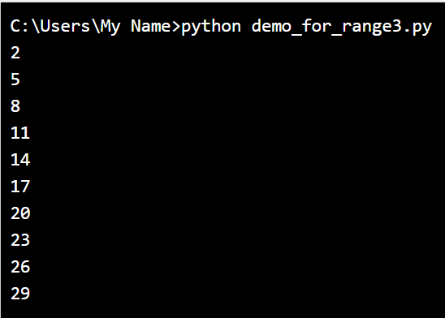
Example
Increment the sequence with 3 (default is 1):
for x in range(2, 30, 3): print(x)

Slide 34
Else in For Loop
The else keyword in a for loop specifies a block of code to be executed when the loop is finished:
Example
Print all numbers from 0 to 5, and print a message when the loop has ended:
for x in range(6):
print(x)
else:
print("Finally finished!")

Slide 35
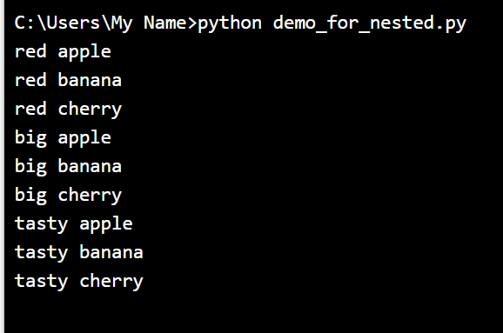
Nested Loops
A nested loop is a loop inside a loop.
The "inner loop" will be executed one time for each iteration of the "outer loop":
Example
Print each adjective for every fruit:
adj = ["red", "big", "tasty"] fruits = ["apple", "banana", "cherry"] for x in adj: for y in fruits: print(x, y)
Reference : https://www.w3schools.com/python/python_for_loops.asp

Slide 36
Note:
What is meant by structured language?
C is called a structured programming language because to solve a large problem, C programming language divides the problem into smaller modules called functions or procedures each of which handles a particular responsibility. The program which solves the entire problem is a collection of such functions
Examples of Structured Programming language are C, C+, C++, C#, Java, PERL, Ruby, PHP, ALGOL, Pascal, PL/I and Ada
What is unstructured programming language?
An unstructured program is a procedural program – the statements are executed in sequence as written. But this type of programming uses the goto statement. A goto statement allows control to be passed to any other place in the program. ... This means that it is often difficult to understand the logic of such a program.
Examples of unstructured Programming language are JOSS, FOCAL, MUMPS, TELCOMP, COBOL

Slide 37
Procedural Programming Paradigm
Session 6 – 10 covers the following Topics:-
Procedural Programming Paradigm
Routines, Subroutines, functions
Using Functions in Python
logical view, control flow of procedural programming in various aspects
Other languages: Bliss, ChucK, Matlab
Demo: creating routines and subroutines using functions in Python
Lab 2: Procedural Programming
TextBook: Shalom, Elad. A Review of Programming Paradigms Throughout the History: With a Suggestion Toward a Future Approach, Kindle Edition

Slide 38
Procedure Oriented Programming(POP):-
High level languages such as COBOL, FORTRAN and C, is commonly known as procedure oriented programming(POP). In the procedure oriented programming, program is divided into sub programs or modules and then assembled to form a complete program. These modules are called functions.
The problem is viewed as a sequence of things to be done.
The primary focus is on functions.
Procedure-oriented programming basically consists of writing a list of instructions for the computer to follow and organizing these instructions into groups known as functions.

Slide 39
In a multi-function program, many important data items are placed as global so that they may be accessed by all functions. Each function may have its own local data. If a function made any changes to global data, these changes will reflect in other functions. Global data are more unsafe to an accidental change by a function. In a large program it is very difficult to identify what data is used by which function.
This approach does not model real world problems. This is because functions are action-oriented and do not really correspond to the elements of the problem.

Slide 40
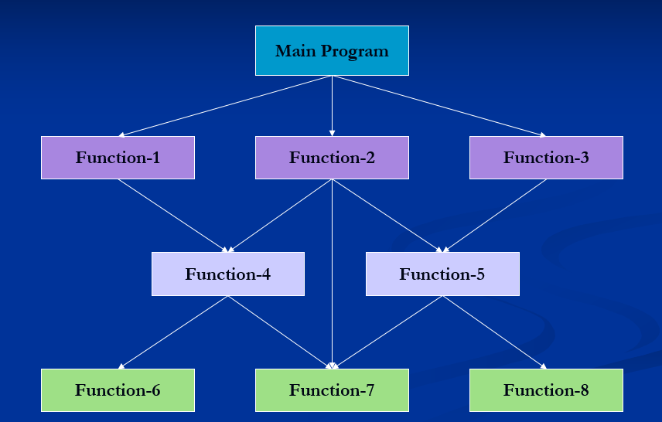
Typical structure of procedure-oriented program

Slide 41
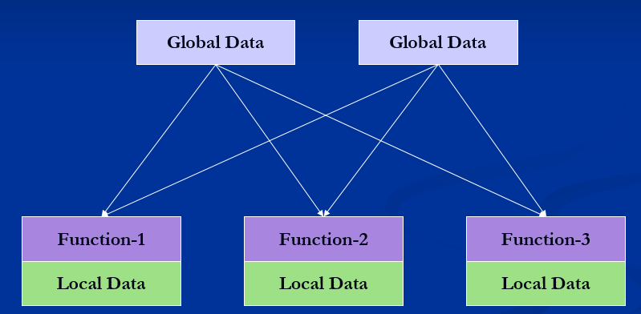
Relationship of data and functions in procedural programming

Slide 42
Characteristics of Procedure-Oriented Programming
Emphasis is on doing things.
Large programs are divided into smaller programs known as functions.
Most of the functions share global data.
Data move openly around the system from function to function.
Functions transform data from one form to another.
Employs top-down approach in program design.

Slide 43
Logical view and Control flow of POP (routine, subroutine and function)
Procedural programming is a programming paradigm, derived from structured programming, based on the concept of the procedure call. Procedures, also known as routines, subroutines, or functions, simply contain a series of computational steps to be carried out. Any given procedure might be called at any point during a program's execution, including by other procedures or itself.
procedural languages generally use reserved words that act on blocks, such as if, while, and for, to implement control flow, whereas non-structured imperative languages use goto statements and branch tables for the same purpose.
Note:
Subroutine:-
Subroutines; callable units such as procedures, functions, methods, or subprograms are used to allow a sequence to be referred to by a single statement.

Slide 44
Function in python
A function is a block of organized, reusable code that is used to perform a single, related action. Functions provide better modularity for your application and a high degree of code reusing.
There are 2 types of function
Built-in function ex. Print()
User defined function -User can create their own functions.

Slide 45
Defining a Function
Function blocks begin with the keyword def followed by the function name and parentheses ( ( ) ).
Any input parameters or arguments should be placed within these parentheses. You can also define parameters inside these parentheses.
The first statement of a function can be an optional statement - the documentation string of the function or docstring.
The code block within every function starts with a colon (:) and is indented.
The statement return [expression] exits a function, optionally passing back an expression to the caller. A return statement with no arguments is the same as return None.

Slide 46
Syntax:
def functionname( parameters ):
"function_docstring"
function_suite
return [expression]
Example:
#function definition
def my_function(): print("Hello from a function")
# To call a function, use the function name followed by parenthesis: my_function()

Slide 47
Function Arguments
You can call a function by using the following types of formal arguments −
Required arguments
Keyword arguments
Default arguments
Variable-length arguments

Slide 48
Required arguments
Required arguments are the arguments passed to a function in correct positional order. Here, the number of arguments in the function call should match exactly with the function definition.
To call the function printme(), you definitely need to pass one argument, otherwise it gives a syntax error as follows −
# Function definition is here
def printme( str ):
"This prints a passed string into this function"
print str
return;
# Now you can call printme function
printme()
When the above code is executed, it produces the following result −
Traceback (most recent call last):
File "test.py", line 11, in <module>
printme();
TypeError: printme() takes exactly 1 argument (0 given)

Slide 49
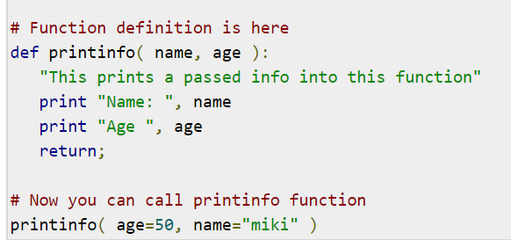
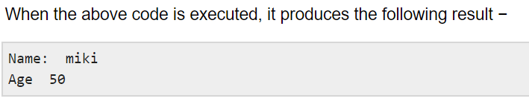
Keyword arguments
Keyword arguments are related to the function calls. When you use keyword arguments in a function call, the caller identifies the arguments by the parameter name.
This allows you to skip arguments or place them out of order because the Python interpreter is able to use the keywords provided to match the values with parameters. You can also make keyword calls to the printme() function in the following ways − Ex2:-
Ex1: # Function definition is here
def printme( str ):
"This prints a passed string into this function"
print str
return;
# Now you can call printme function
printme( str = "My string")
When the above code is executed,
it produces the following result −
O/p -> My string
Note that the order of parameters does not matter

Slide 50
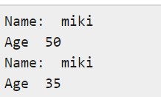
Default arguments
A default argument is an argument that assumes a default value if a value is not provided in the function call for that argument. The following example gives an idea on default arguments, it prints default age if it is not passed −
# Function definition is here
def printinfo( name, age = 35 ):
"This prints a passed info into this function"
print "Name: ", name
print "Age ", age
return;
# Now you can call printinfo function
printinfo( age=50, name="miki" )
printinfo( name="miki" )
When the above code is executed, it produces the following result −

Slide 51
Variable-length arguments
You may need to process a function for more arguments than you specified while defining the function. These arguments are called variable-length arguments and are not named in the function definition, unlike required and default arguments.
Syntax for a function with non-keyword variable arguments is this −
def functionname([formal_args,] *var_args_tuple ):
"function_docstring"
function_suite
return [expression]
An asterisk (*) is placed before the variable name that holds the values of all nonkeyword variable arguments. This tuple remains empty if no additional arguments are specified during the function call. Following is a simple example −

Slide 52
# Function definition is here
def printinfo( arg1, *vartuple ):
"This prints a variable passed arguments"
print "Output is: "
print arg1
for var in vartuple:
print var
return;
# Now you can call printinfo function
printinfo( 10 ) When the above code is executed, it produces the following result −
Output is:
10
Output is: printinfo( 70, 60, 50 )
70
60
50

Slide 53
The Anonymous Functions
These functions are called anonymous because they are not declared in the standard manner by using the def keyword. You can use the lambda keyword to create small anonymous functions.
Lambda forms can take any number of arguments but return just one value in the form of an expression. They cannot contain commands or multiple expressions.
An anonymous function cannot be a direct call to print because lambda requires an expression
Lambda functions have their own local namespace and cannot access variables other than those in their parameter list and those in the global namespace.
Although it appears that lambda's are a one-line version of a function, they are not equivalent to inline statements in C or C++, whose purpose is by passing function stack allocation during invocation for performance reasons.
Syntax
The syntax of lambda functions contains only a single statement, which is as follows −
lambda [arg1 [,arg2,.....argn]]:expression
Following is the example to show how lambda form of function works −

Slide 54
# Function definition is here
sum = lambda arg1, arg2: arg1 + arg2;
# Now you can call sum as a function
print "Value of total : ", sum( 10, 20 )
print "Value of total : ", sum( 20, 20 )
When the above code is executed, it produces the following result −
O/p
Value of total : 30
Value of total : 40
The return Statement
The statement return [expression] exits a function, optionally passing back an expression to the caller. A return statement with no arguments is the same as return None.
All the above examples are not returning any value. You can return a value from a function as follows −

Slide 55
# Function definition is here
def sum( arg1, arg2 ):
# Add both the parameters and return them."
total = arg1 + arg2
print "Inside the function : ", total
return total;
# Now you can call sum function
total = sum( 10, 20 );
print "Outside the function : ", total
When the above code is executed, it produces the following result −
Inside the function : 30
Outside the function : 30

Slide 56
Scope of Variables
All variables in a program may not be accessible at all locations in that program. This depends on where you have declared a variable.
The scope of a variable determines the portion of the program where you can access a particular identifier. There are two basic scopes of variables in Python −
Global variables
Local variables
Global vs. Local variables
Variables that are defined inside a function body have a local scope, and those defined outside have a global scope.
This means that local variables can be accessed only inside the function in which they are declared, whereas global variables can be accessed throughout the program body by all functions. When you call a function, the variables declared inside it are brought into scope. Following is a simple example −

Slide 57
total = 0; # This is global variable.
# Function definition is here
def sum( arg1, arg2 ):
# Add both the parameters and return them."
total = arg1 + arg2; # Here total is local variable.
print "Inside the function local total : ", total
return total;
# Now you can call sum function
sum( 10, 20 );
print "Outside the function global total : ", total
When the above code is executed, it produces the following result −
Inside the function local total : 30
Outside the function global total : 0

Slide 58
3. Object-Oriented Programming
Session 11-15 covers the following Topics:-
Object Oriented Programming Paradigm
Class, Objects,Instances, Methods
Encapsulation,Data Abstraction
Polymorphism,Inheritance
Constructor,Destructor
Example Languages: BETA,Cecil, Lava.
Demo: OOP in Python
Lab 3: Object Oriented Programming
TextBook: Shalom, Elad. A Review of Programming Paradigms Throughout the History: With a Suggestion Toward a Future Approach

Slide 59
Object-Oriented Programming
OOP treat data as a critical element in the program development and does not allow it to flow freely around the system.
It ties data more closely to the functions that operate on it, and protects it from accidental modification from outside functions.
OOP allows decomposition of a problem into a number of entities called objects and then build data functions around these objects.
The data of an object can be accessed only by the functions associated with that object.
Functions of one object can access the functions of another objects

Slide 60
Organization of data and functions in OOP
Object A
Object B
Data
Data
Communication
Functions
Functions
Object C
Data
Functions

Slide 61
Characteristics of Object-Oriented Programming
Emphasis is on data rather than procedure.
Programs are divided into objects.
Data structures are designed such that they characterize the objects.
Functions that operate on the data of an object are tied together in the data structure.
Data is hidden and can not be accessed by external functions.
Objects may communicate with each other through functions.
New data and functions can be added easily whenever necessary.
Follows bottom-up approach in program design.

Slide 62
Object-Oriented Programming
Definition:
It is an approach that provides a way of modularizing programs by creating partitioned memory area for both data and functions that can be used as templates for creating copies of such modules on demand. Thus the object is considered to be a partitioned area of computer memory that stores data and set of operations that can access that data.

Slide 63
Basic Concepts of Object-Oriented Programming
Objects
Classes
Data Abstraction and Encapsulation
Inheritance
Polymorphism
Dynamic Binding
Message Passing

Slide 64
Basic Concepts of OOP
continue …
Objects
Objects are the basic run-time entities in an object-oriented system. They may represent a person, a place, a bank account, etc. Objects take up space in the memory and have an associated address like a structure in C.
When a program is executed, the objects interact by sending messages to one another.

Slide 65
Basic Concepts of OOP
continue …
Objects
Object : CUSTOMER
Object : ACCOUNT
DATA
AC No.
Name of AC Holder
Address
DATA
AC No.
AC Balance
Type of Account
FUNCTIONS
Deposit
Withdrawal
AC Balance Display
FUNCTIONS
Account Balance

Slide 66
Basic Concepts of OOP
continue …
Classes
Classes are user-defined data types.
The entire set of data and code of an object can be made a user-defined data type with the help of a class. Objects are variables of the type class. Once a class has been defined, we can create any number of objects belonging to that class. Each object is associated with the data of type class with which they are created.
A class is a collection of objects of similar type.

Slide 67
Basic Concepts of OOP
continue …
Classes
If fruit has been defined as a class, then the statement
f r u i t m a n g o ;
will create an object mango belonging to the class fruit.

Slide 68
Basic Concepts of OOP
continue …
Data Abstraction and Encapsulation
The wrapping up of data and functions into a single unit is known as encapsulation.
The data is not accessible to the outside world, and only those functions which are wrapped in the class can access it.
These functions provide the interface between the object’s data and the program. This insulation of the data from direct access by the program is called data hiding or information hiding.

Slide 69
Basic Concepts of OOP
continue …
Data Abstraction and Encapsulation
The attributes wrapped in the classes are called data members and the functions that operate on these data are called methods or member functions.
Since the classes use the concept of data abstraction, they are known as Abstracted Data Types (ADT).

Slide 70
Basic Concepts of OOP
continue …
Inheritance
Inheritance is the process by which objects of one class acquire the properties of objects of another class.
It supports the concept of hierarchical classification.
Each derived class shares common characteristics with the class from which it is derived.

Slide 71
Property Inheritance
Bird
Attributes:
Feathers
Lay eggs
Flying Bird
Non-flying Bird
Attributes:
------------
------------
Attributes:
------------
------------
Robin
Swallow
Penguin
Kiwi
Attributes:
------------
------------
Attributes:
------------
------------
Attributes:
------------
------------
Attributes:
------------
------------

Slide 72
Basic Concepts of OOP
continue …
Inheritance
Inheritance provides the idea of reusability.
We can add additional features to an existing class without modifying it.
(By deriving new class from existing one. The new class will have the combined features of both the classes.)

Slide 73
Basic Concepts of OOP
continue …
Polymorphism - ability to take more than one form
An operation may exhibit different behaviours in different instances.
The behaviour depends upon the types of data used in the operation.
add( 3, 5) gives 8
Add(“hello”, “-world”) gives “hello-world”

Slide 74
Basic Concepts of OOP
continue …
Polymorphism - ability to take more than one form
The process of making an operator to exhibit different behaviours in different instances is known as operator overloading.
<< Insertion Operator
<< Left-shift bit-wise operator
Using a single function name to perform different types of tasks is known as function overloading.
add( 3, 5) gives 8
Add(“hello”, “-world”) gives “hello-world”

Slide 75
Basic Concepts of OOP
continue …
Dynamic Binding
Binding refers to the linking of a procedure call to the code to be executed in response to the call.
Dynamic binding ( late binding ) means that the code associated with a given procedure call is not known until the time of the call at run-time.
It is associated with polymorphism and inheritance.

Slide 76
Basic Concepts of OOP
continue …
Message Passing
An oop consists of a set of objects that communicate with each other.
Oop involves the following steps:
Creating classes that define objects and their behaviour.
Creating objects from class definitions.
Establishing communication among objects.
Objects communicate with one another by sending and receiving information.

Slide 77
Basic Concepts of OOP
continue …
Message Passing
A message for an object is a request for execution of a procedure.
The receiving object will invoke a function and generates results.
Message passing involves specifying:
The name of the Object.
The name of the Function.
The information to be send.

Slide 78
Benefits of OOP
Inheritance – eliminate redundant code and extend the use of existing classes.
We can build programs from the standard working module, no need of starting from the scratch.
Data hiding helps the programmer to build secure programs that can not be invaded by code in other parts of the program.

Slide 79
Benefits of OOP
continue …
Multiple instances of an objects can co-exists with out any interference.
It is easy to partition the work in a project based on objects.
Object-oriented system can be easily upgraded from small to large systems.
Message passing techniques for communication between objects makes the interface descriptions with external systems much simpler.
Software complexity can be easily managed.

Slide 80
5.Declarative paradigm
Unit- 2 (15 Session )
Session 6-10 covers the following Topics:-
Definition Declarative Paradigm
Sets of Declarative Statements
Object Attribute and Binding behavior
Creating Event without describing flow
Other languages: Prolog, Z3, LINQ, SQL
Demo: Declarative Programming in Python
Lab 5: Declarative Programming
TextBook: Shalom, Elad. A Review of Programming Paradigms Throughout the History: With a Suggestion Toward a Future Approach, Kindle Edition

Slide 81
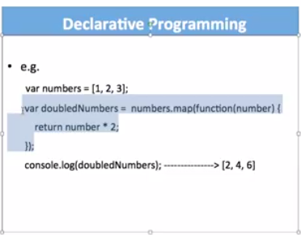
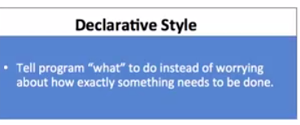
1. Declarative paradigm
Declarative programming is a programming paradigm that expresses the logic of a computation without describing its control flow.
Logic, functional and domain-specific languages belong under declarative paradigms
Examples would be HTML, XML, CSS, SQL, Prolog, Haskell, F# and Lisp.
Declarative code focuses on building logic of software without actually describing its flow. You are saying what without adding how. For example with HTML you use <img src="./image.jpg" /> to tell browser to display an image and you don’t care how it does that.

Slide 82
1.1 History
The two main subparadigms of declarative programming are
functional Programming
&
logic programming.
Functional and logical programming languages are characterized by a declarative programming style.
In logical programming languages, programs consist of logical statements, and the program executes by searching for proofs of the statements.

